Slide 1
Creating a Cultural Competency Curriculum
AUR19
Nolan Kagetsu, MD, FACR
April 10, 2019
he/his
Notes:
Additional resources can be found at https://sites.google.com/site/neuroradiologyprimer/diversity-curriculum
Please feel free to contact nolan.Kagetsu@moutnsinai.org if you have any questions

Slide 2
Goals
Intro
Competence v Humility
Respect for patients
Respect for colleagues
Disparities
Microagressions
Other examples

Slide 3
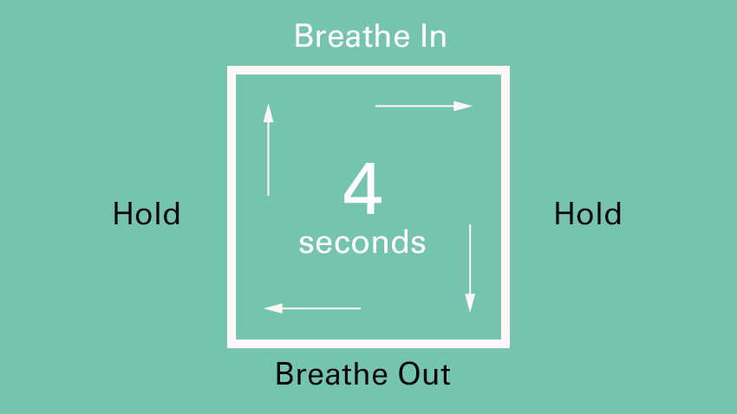
Square breathing
Notes:
Do square breathing to welcome and reset everyone for the presentation (this is used by the FDNY)

Slide 4
Intro Cultural Competency for Radiology Electives
Should synchronize with other classes/rotations
Be mindful of opportunities to discuss on our rotations

Slide 5
Cultural Humility v Cultural Competence (1998)
Notes:
This is a classic article introducing the term cultural humility

Slide 6
Cultural Competence fail
Hispanic pt not given pain meds
Nurse “knew” that Hispanic patients overexpress “the pain they are feeling”
Notes:
This is an example from the Tervalon article

Slide 7
Cultural Competence fail
Hispanic pt not given pain meds
Nurse “knew” that Hispanic patients overexpress “the pain they are feeling”
Humility acknowledges that we are always learning

Slide 9
Respect for patients
Pt “refused” contrast
Pt was “uncooperative”
Notes:
We should avoid using the term “refused” or “uncooperative” in reports.
I use the phrase. Patient declined the use of IV contrast or patient was unable to complete protocol.

Slide 10
Respect for patients
Pt “refused” contrast
Pt was “uncooperative”
Pt “declined” contrast

Slide 11
Respect for patients
Pt “refused” contrast
Pt was “uncooperative”
Pt “declined” contrast
Pt was “unable to complete the protocol”

Slide 12
Respect for colleagues
Starbucks name
Notes:
One way to show respect is to make an effort to pronounce someone’s name properly (as opposed to using a “Starbucks name” see https://whatsmystarbucksname.com/

Slide 13
Respect for colleagues
Starbucks name
Nafisa to Sarah

Slide 14
Respect for colleagues
Starbucks name
Nafisa to Sarah
Ugwueze
Notes:
One work colleague did not want to try to pronounce the name Ugwueze, when is was the name African colonizers forced the Nigerians to use!

Slide 15
Disparities
Although the breast cancer death rate in the United States has decreased by 43% for white women since 1980, it has dropped by only 23% for African American women.
The incidence of breast cancer among African American women has been rising steadily in the United States and in 2012 reached the same level as in white women.
African American women are 42% more likely to die from breast cancer than are non-Hispanic white women.
Notes:
An example of a health disparity

Slide 16
VIR
Fibroid/UAE
Notes:
An example of a VIR health disparity i

Slide 17
Microaggression
Notes:
Microaggression is one of the terms in the glossary on the ACR website https://docs.google.com/document/d/1exITC1ZUT3jlv7a-IUyccMdVV1fNrep13UnwL2qYYLY/edit?usp=sharing

Slide 18
Microaggression
A statement, action, or incident regarded as an instance of indirect, subtle, or unintentional discrimination against members of a marginalized group such as a racial or ethnic minority.
As Brenda Allen (AUR 2016 keynote speaker) noted, a “mosquito bite” as opposed to a “shark bite”
e.g.:
"So where are you really from?" (see perpetual foreigner)
Commenting that an African American is “articulate”
Google [microagression mosquito bite]

Slide 19
Microagressions
Recognize
Be an ally

Slide 20
nolan.kagetsu@mountsinai.org
@nkagetsu

