Slide 1
Actions to Address Health Care Disparities in Radioloigy
Carolynn M. DeBenedectis, MD
Associate Professor
Vice Chair for Education
Director, Residency Program
Department of Radiology, Division of Breast Imaging
University of Massachusetts Medical School/UMass Memorial Medical Center

Slide 2



How do we solve healthcare disparities in Radiology?
Clinician Education
Patient education
Outreach
Cultural Competency
  Unconscious Bia Training
Diverse Radiology Workforce

Slide 3
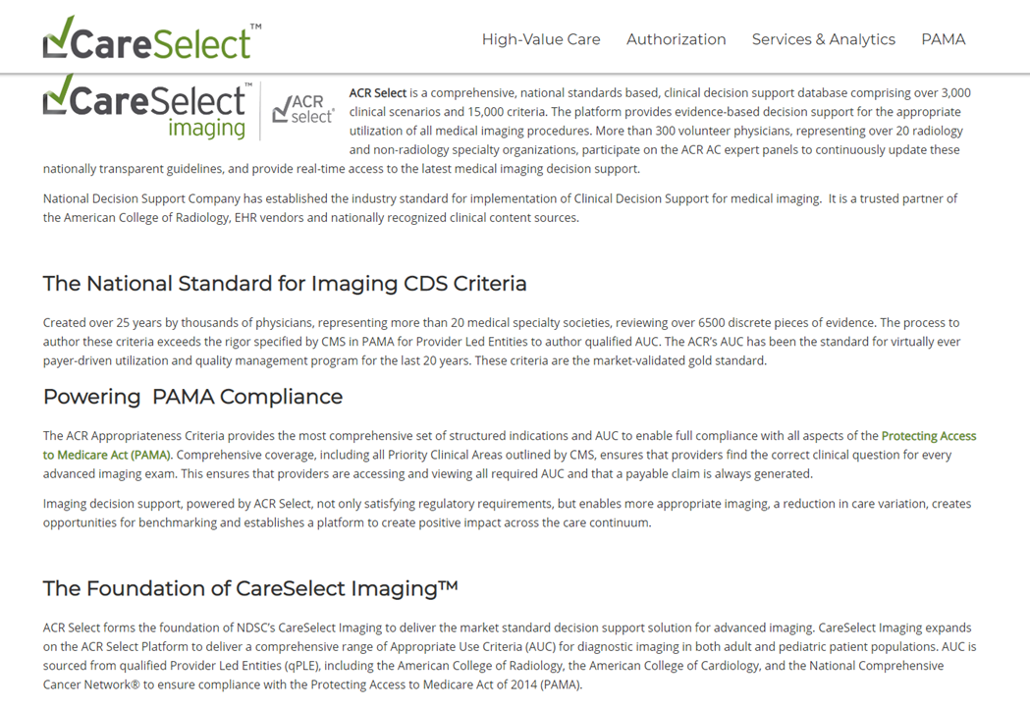
Clinician Education
Create standardized care pathways to remove physician bias
  Evidence-based
  Standardized recommendations for incidental findings
  ACR Appropriateness Criteria
R-SCAN
  Informatics-based solution that facilitates collaboration between radiologists and referring clinicians to mitigate healthcare disparities through optimization in imaging utilization
ACR Select
Wang KY et al. Radiology Support, Communication, and Alignment Network and Its Role to Promote Health Equity in the Delivery of Radiology Care. J Am Coll Radiol 2019; 16: 638-643.

Slide 4
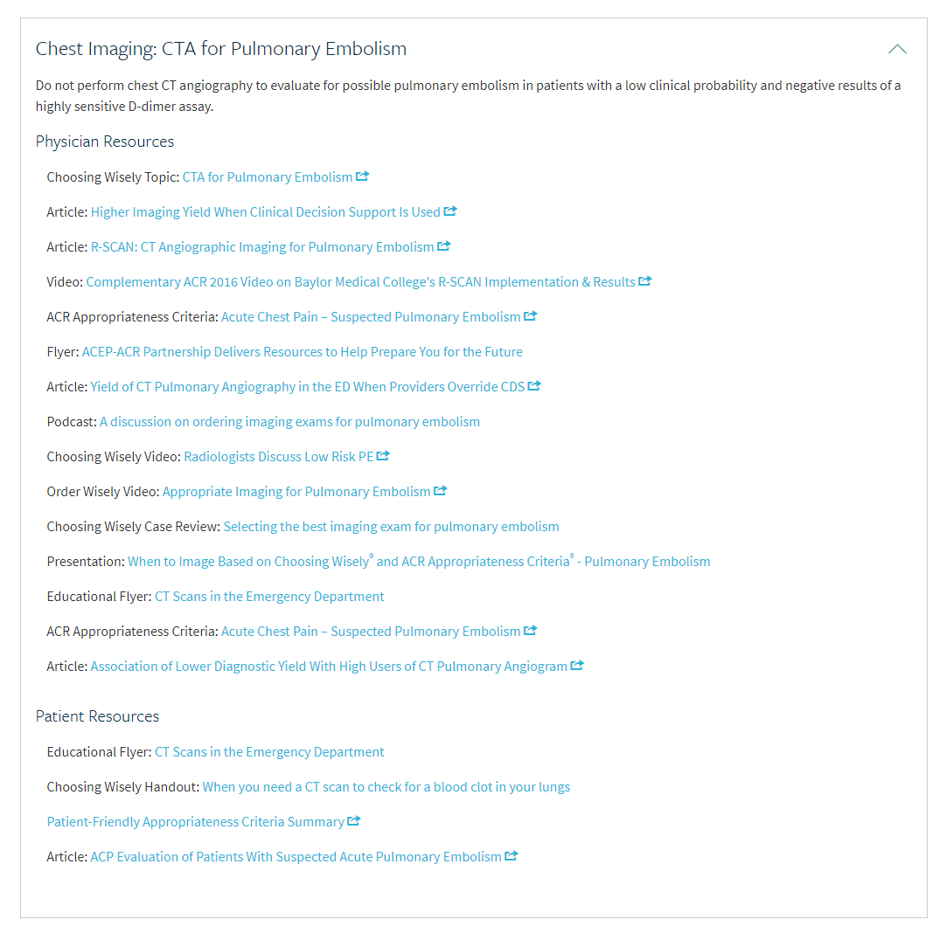
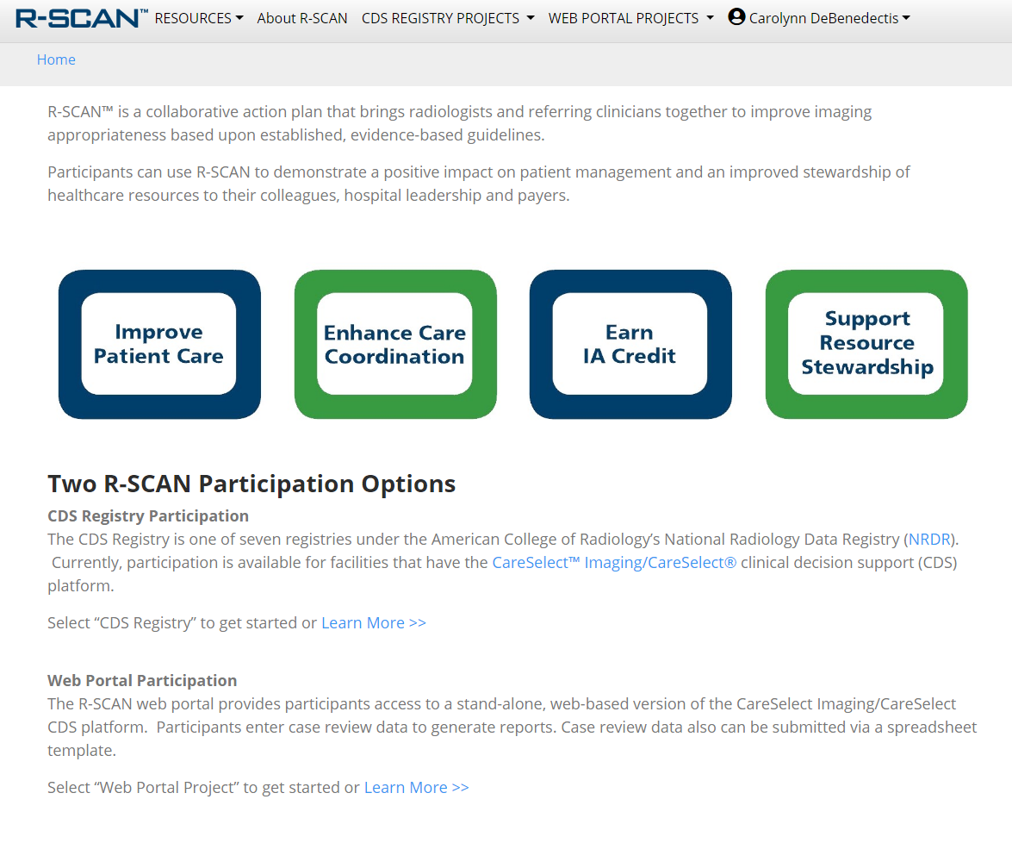

Slide 5
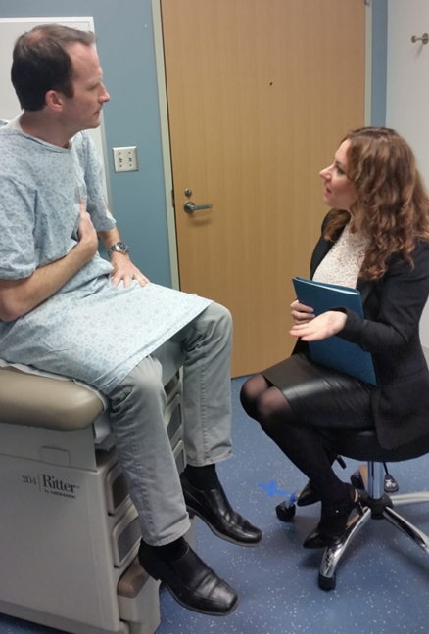
Patient Education
Create informational pamphlets
  For multiple literacy levels
  in multiple languages
Create informational videos
  In multiple languages
Multi-media enhanced reports
  Hyperlinks
  Annotated images
Patient Friendly ACR Appropriateness Criteria
Provide one on one patient education to at risk patients
Folio LR et al. Multimedia-enhanced radiology reports: Concept, components, and challenges. Radiographics 2018;38:463-82.

Slide 6
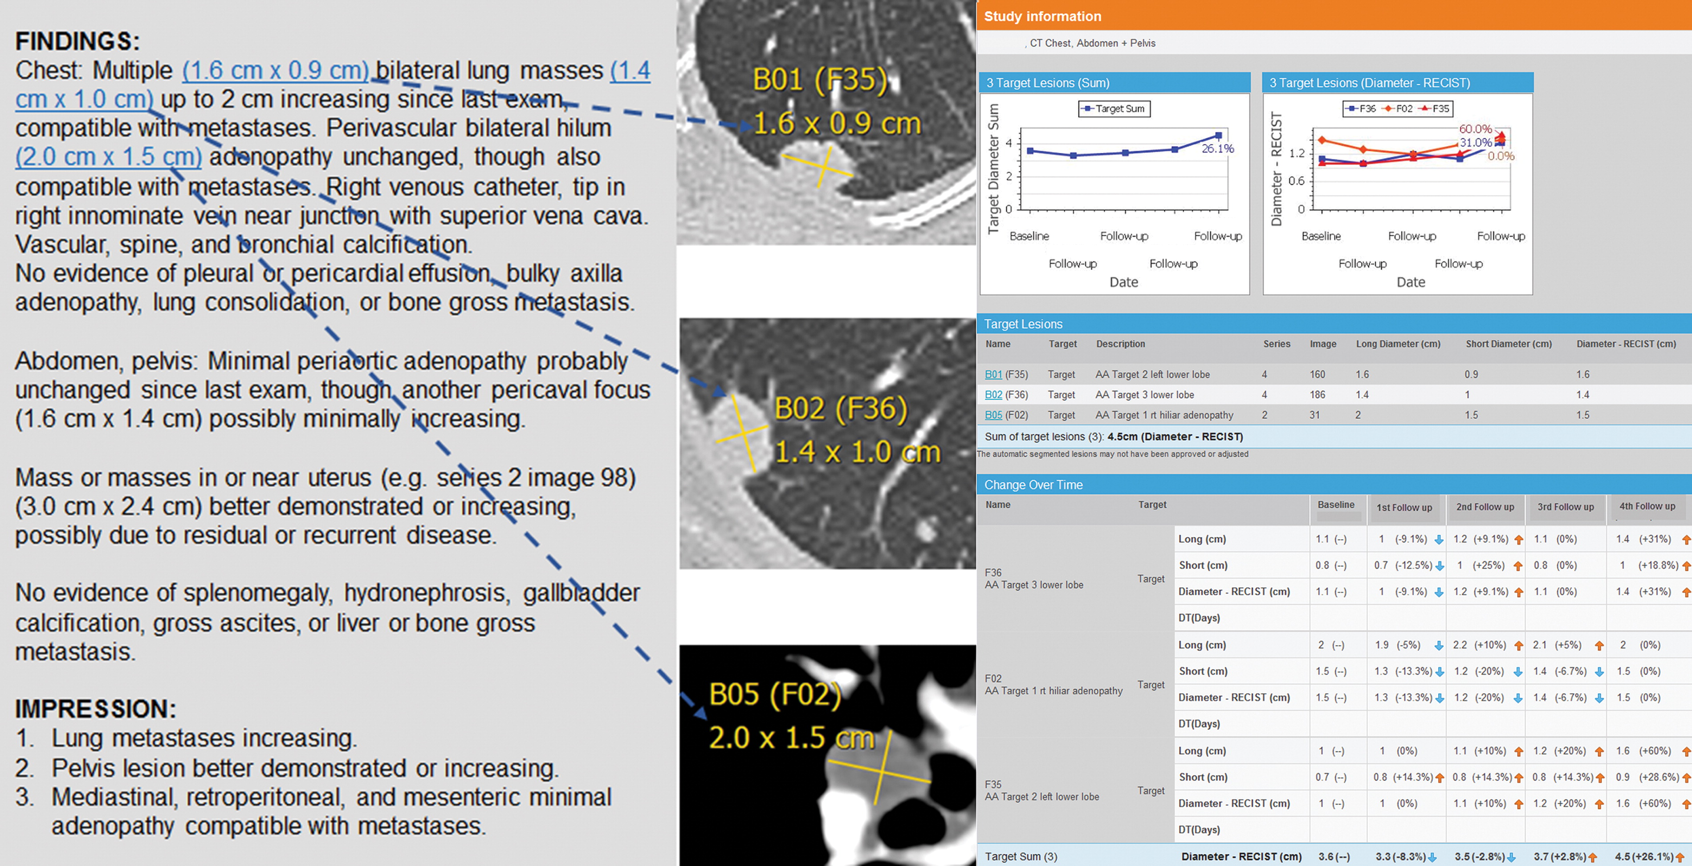

Folio LR. Published Online: March 12, 2018
https://doi.org/10.1148/rg.2017170047

Slide 7
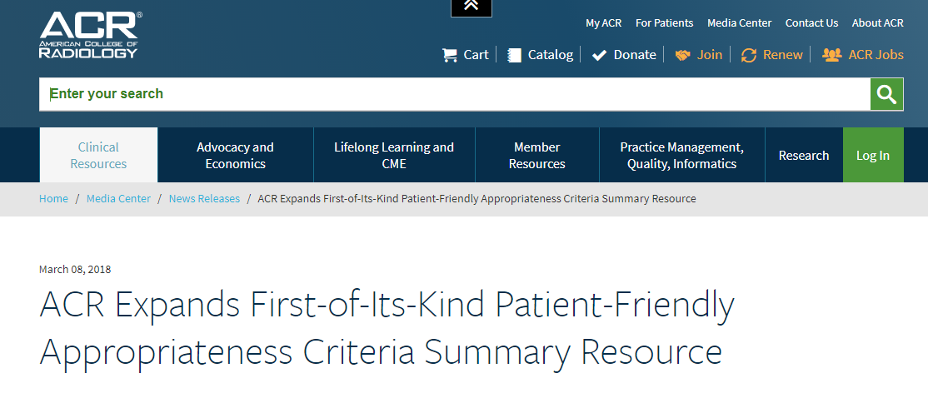
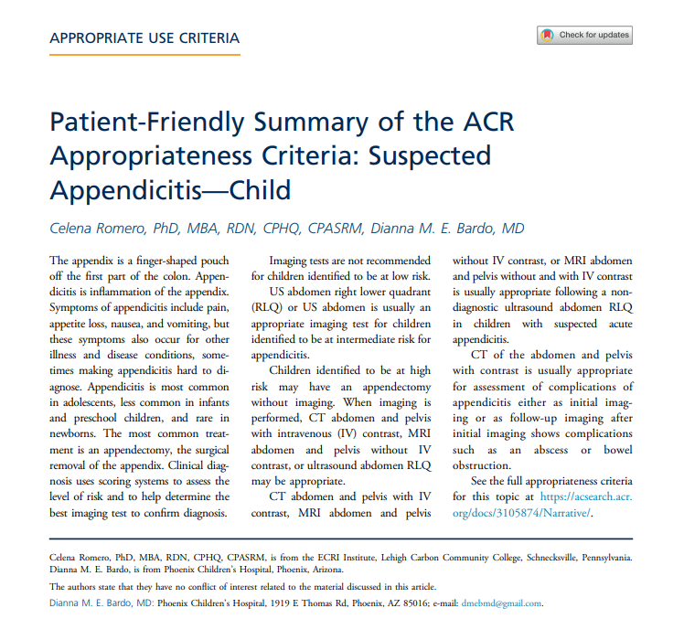

Slide 8



Outreach
Advocate for better coverage of radiologic screening exams for all patients
Provide transportation from areas where disparities exist to screening sites
Appointment reminders
Work to remove structural barriers to access
  Be mindful of locations of screening and service sites
Have targeted advertising for your imaging center toward groups who experience inequity
Collaborate with local organizations (churches, community centers, etc)
Advertise you have medical interpreters available
Get support and partner with community leaders

Slide 9
Cultural Competency
Behaviors, attitudes, and policies that consistently guide health care systems, agencies, and personnel and enable them to work effectively in cross-cultural situations
OR
Ability of health care providers and systems to care for patients with diverse values, beliefs, and behaviors in a manner that meets their social, cultural, and linguistic needs
Goal of cultural competency is a health care system and workforce that delivers the highest quality care to every patient
  regardless of race, ethnicity, cultural background, or language proficiency
Cultural competency training for staff, technologist and radiologist
Implicit bias training
Creating a culturally competent environment for patients
  Signs, reading materials, staff behavior, intepreters, etc

Slide 10
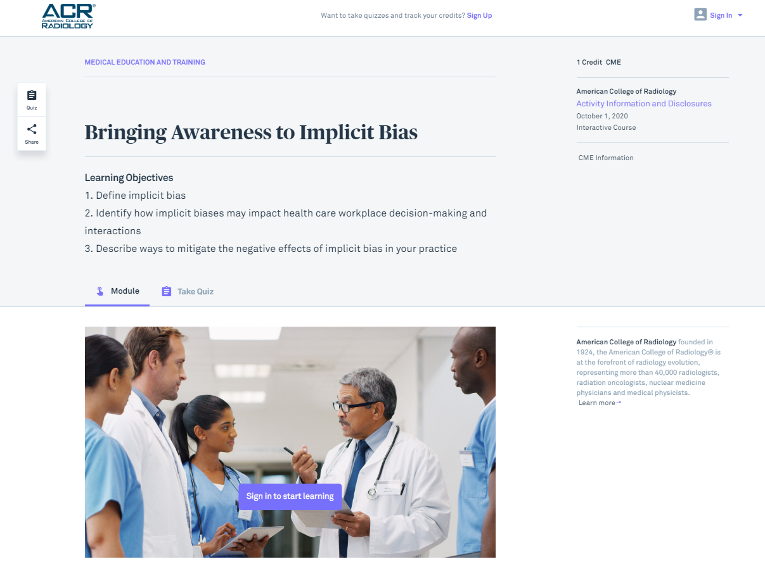
https://edhub.ama-assn.org/acr-lifelong-learning/interactive/18544954

Slide 11

Diverse Radiology Workforce
A way of achieving cultural competence of service providers
Allows for the variety of values and beliefs that exists among the patient population is then also represented by members of the workforce
Patients want, and feel more comfortable, with doctors who look like them and have a similar background
Jackson CS et al. Addressing health and health-care disparities: The role of a diverse workforce and the social determinates of health. Public Health rep 2014; 129:57-61

Slide 12
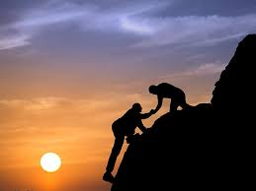
How can YOU help
Educate yourself on disparities in Radiology
Educate referring clinicians about these disparities
  R-SCAN and ACR Select
Educate patients about the Radiology services available to them
  Consider education level, literacy, languages, etc
Start outreach programs to help at risk patients in your area
  Help patients with transportation
  Have clear transparent cost and payment plans
  Look into why patients no show and try to help
Become culturally competent
Learn about implicit bias and how to combat it
Recruit diverse radiology faculty and trainees

