Slide 1
Creating a Cultural Competency Curriculum
AUR19
Nolan Kagetsu, MD, FACR
April 10, 2019
he/his

Slide 2
Disclosure
Partner is employee at Pfizer

Slide 3
Goals
Intro
Competence v Humility
Respect for patients
Respect for colleagues
Disparities
Microagressions
Other examples

Slide 4


Square breathing

Slide 5
Intro
Cultural Competency for Radiology Electives
Should synchronize with other classes/rotations
Be mindful of opportunities to discuss on our rotations

Slide 6
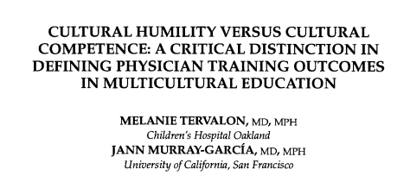
Cultural Humility v Cultural Competence (1998)

Slide 7
Cultural Competence fail
Hispanic pt not given pain meds
Nurse “knew” that Hispanic patients overexpress “the pain they are feeling”

Slide 8
Cultural Competence fail
Hispanic pt not given pain meds
Nurse “knew” that Hispanic patients overexpress “the pain they are feeling”
Humility acknowledges that we are always learning

Slide 9
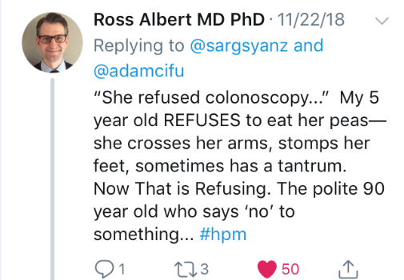

Slide 10
Respect for patients
Pt “refused” contrast
Pt was “uncooperative”

Slide 11
Respect for patients
Pt “refused” contrast
Pt was “uncooperative”
Pt “declined” contrast

Slide 12
Respect for patients
Pt “refused” contrast
Pt was “uncooperative”
Pt “declined” contrast
Pt was “unable to complete the protocol”

Slide 13
Respect for colleagues
Starbucks name

Slide 14
Respect for colleagues
Starbucks name
Nafisa to Sarah

Slide 15
Respect for colleagues
Starbucks name
Nafisa to Sarah
Ugueze

Slide 16
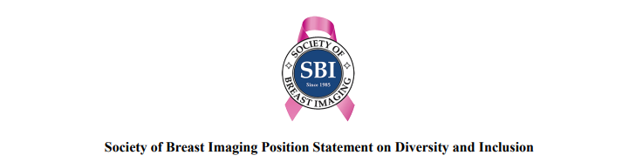
Disparities
Although the breast cancer death rate in the United States has decreased by 43% for white women since 1980, it has dropped by only 23% for African American women.
The incidence of breast cancer among African American women has been rising steadily in the United States and in 2012 reached the same level as in white women.
African American women are 42% more likely to die from breast cancer than are nonHispanic white women.

Slide 17
VIR

Slide 18
VIR
Fibroid/UAE

Slide 19

Microagression

Slide 20
Microagression
A statement, action, or incident regarded as an instance of indirect, subtle, or unintentional discrimination against members of a marginalized group such as a racial or ethnic minority.
As Brenda Allen (AUR 2016 keynote speaker) noted, a “mosquito bite” as opposed to a “shark bite”
e.g.:
"So where are you really from?" (see perpetual foreigner)
Commenting that an African American is “articulate”
Google [microagression mosquito bite]

Slide 21
Microagressions
Recognize
Be an ally

Slide 22




nolan.kagetsu@mountsinai.org
@nkagetsu

