Slide 1



Equity and Access to Imaging
Lucy B. Spalluto, MD MPH
VUMC Department of Radiology

Slide 2
HEALTH EQUITY
Health equity is the absence of avoidable or unfair differences in health outcomes among groups of people, whether those groups are defined socially, economically, demographically or geographically or by other means of stratification.
Everyone has the fair and just opportunity to be as healthy as possible.

Slide 3
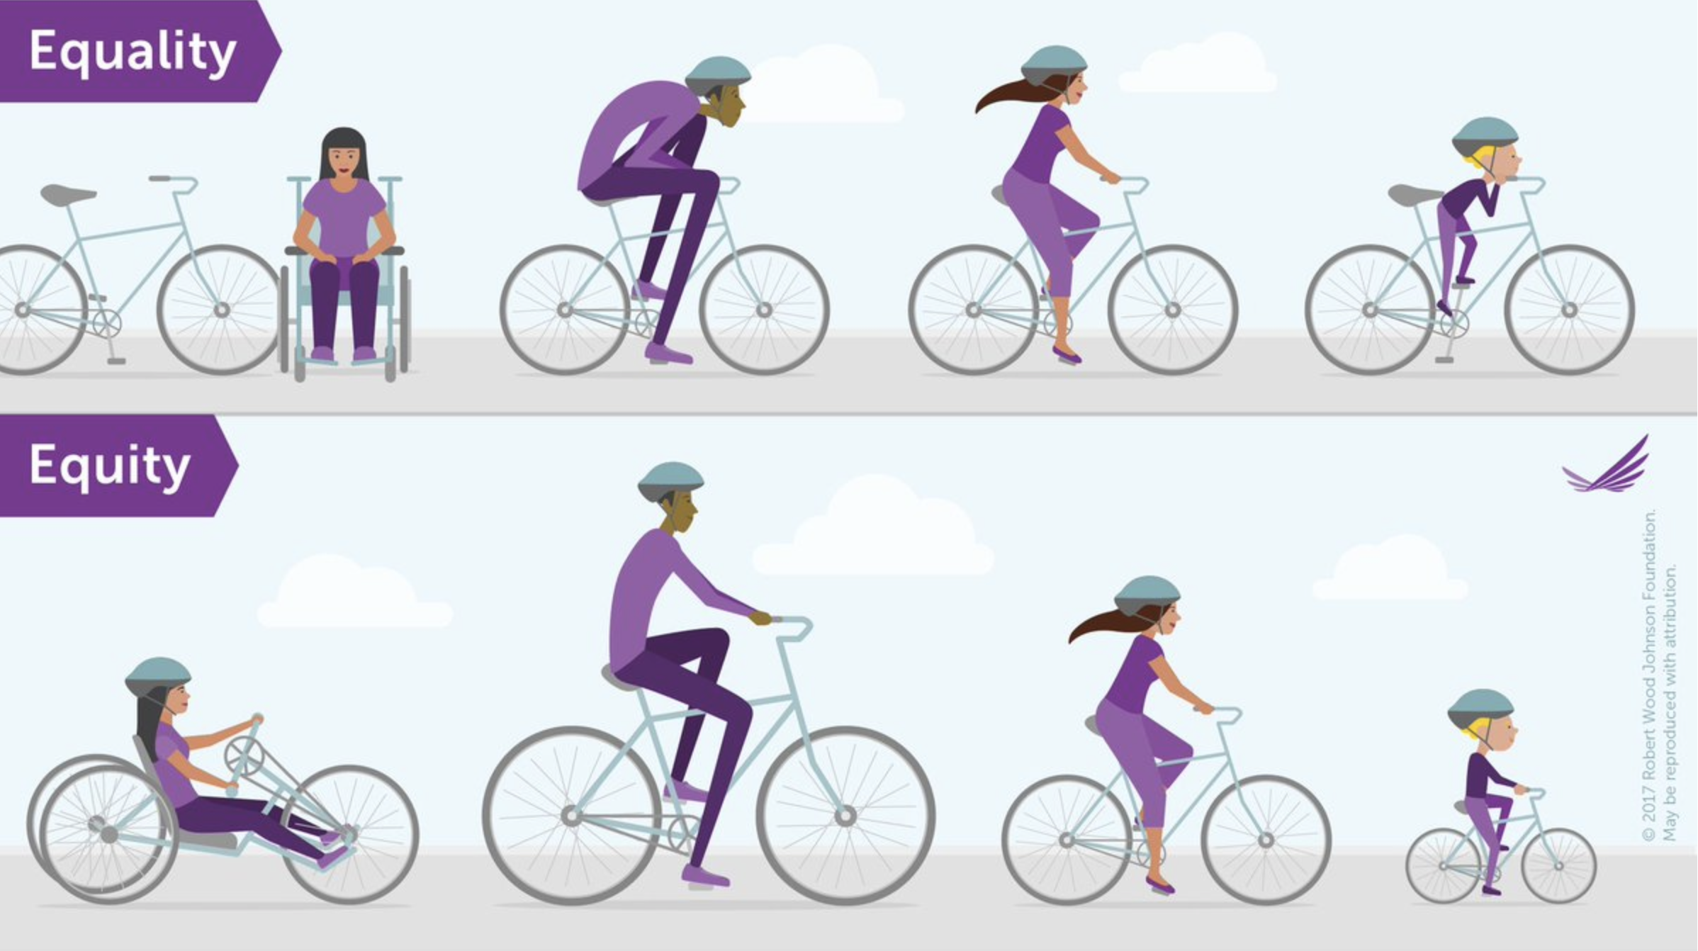
Robert Wood Johnson Foundation

Slide 4
How do we define/measure differences in health outcomes between populations?
Health Disparities:
Any differences in health outcomes between groups of people.
Health Inequities:
Any systemic, avoidable, unfair and unjust differences in health outcomes.

Slide 5
Breast Cancer Disparities
Characteristic (per 100,000) | Black women | White women
Incidence Rate
All ages | 122.9 | 124.4
25-39 years old | 70.6 | 59.9
Mortality Rate
All ages | 28.2 | 20.3
25-39 years old | 10.2 | 5.8
When you look at women of ALL ages, around the same number of Black and White women get breast cancer, but more Black women die from breast cancer.
When you look at younger women, more young Black women get breast cancer and more young Black women die from breast cancer.
For every 10 White women who have a screening mammogram, only 8 of their Black counterparts will.

Slide 6

Insurance
Geography
Communication
Access

Slide 7
Access to comprehensive, quality health services is important for promoting and maintaining health, preventing and managing disease, reducing unnecessary death, and achieving health equity.
3 main components of access :
Insurance – entry/payment to the healthcare system
Geography – physical access to a healthcare facility
Communication – language, patient portals, patient preferences to help us build personal relationships/trust. Understanding the imaging process. Relating to a provider. Helping patients feel as if they are getting the appropriate care.

Slide 8
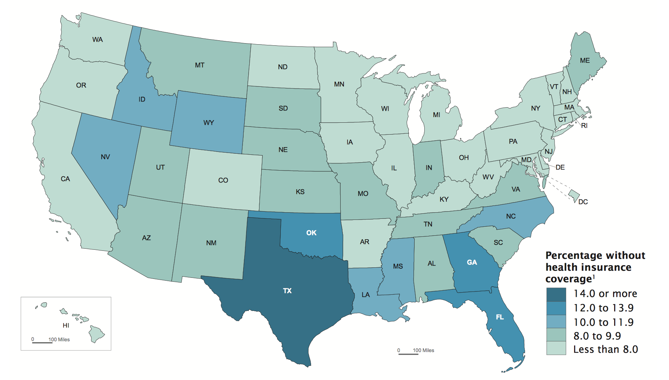



Slide 9
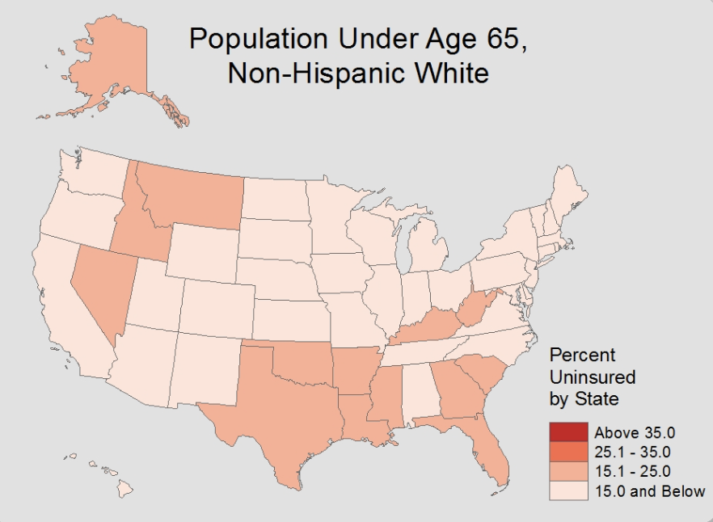
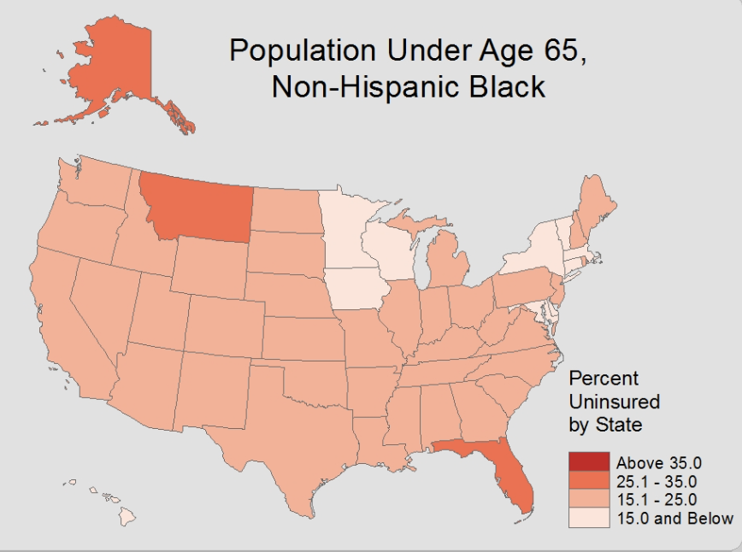
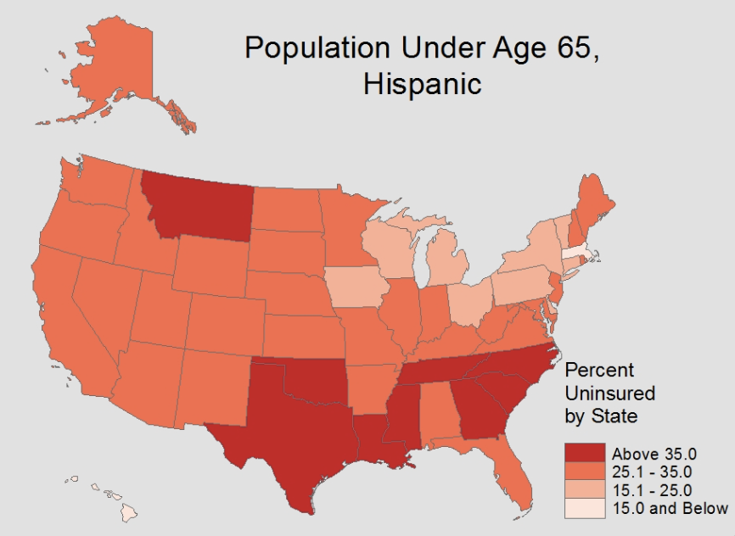


Slide 10
A Tale of Two Screenings…

Slide 11




Rachael’s Day of Mammogram
Rachael has an appointment for a mammogram at 9:30 am.
She has two young children who attend daycare.
She owns her own vehicle.
She is a salaried employee at a large company. She has insurance and can take sick leave and time off.

Slide 12


Lynne’s Day of Mammogram
Lynne has an appointment for a mammogram at 10:00 am.
She has two young children are usually watched by her mother. Her mother is sick.
She uses public transportation.
She is an hourly employee. She does not have insurance and does not have sick leave available.

Slide 13


Comparison of Rachael and Lynne’s Days
Rachael
Lynne
Transportation – own car, 15 minutes
Appointment – on time, 15 minutes
Transportation – bus, 2 hours late
Appointment – 1 hour late, waited additional hour
Sick leave – no pay lost
Insurance – did not have to pay for mammogram
No sick leave – lost pay
No insurance – self paid for mammogram
Children – at daycare
Children – brought with her

Slide 14
How can we improve equity and access to imaging?

Slide 15

Patient-centered research
Recognizing disparity
Improving communication
Leveraging electronic health records

Slide 16
Personalized clinical approaches
Operationalizing equitable care
Systems based thinking

Slide 17

Patient-centered research
BIDIRECTIONAL. Researchers give information to patients AND patients give input to researchers. Research meets the needs of patients and is informed by patients.

Slide 18
Why is patient centered research unique?
PCOR (patient centered outcomes research) includes patient direction in the actual planning and conduct of research
PRO (patient reported outcomes research) captures patient voice as research subjects, improves patient experience
Considers patients as PARTNERS rather than SUBJECTS

Slide 19
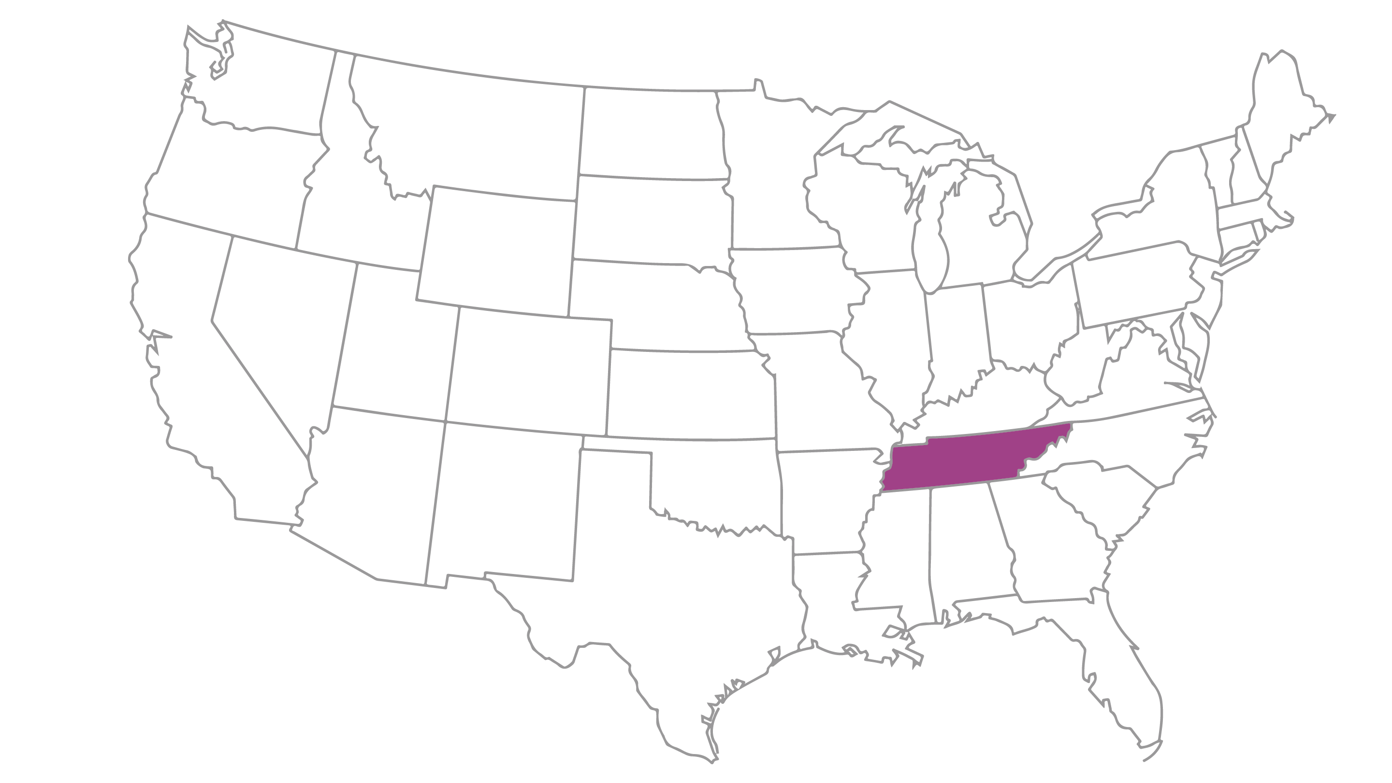
Recognizing disparities
Breast Cancer Mortality Rate
National Disparities: Of all 50 states in the nation, TN has the 7th worst mortality rate from breast cancer.

Slide 20
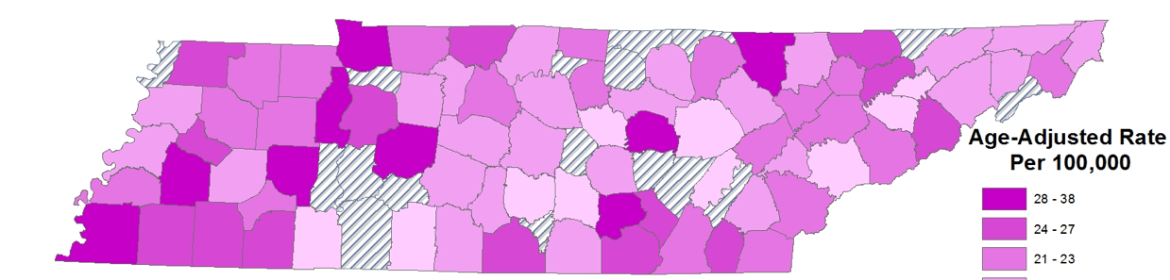
Recognizing disparities
TN Breast Cancer Mortality Rate
by County
Local Disparities: Some communities in TN are more affected by breast cancer than others, in part due to lower access to care. The darker colored counties on this map demonstrate the counties with the highest breast cancer mortality rates. Patient outreach and research studies must not only target the larger academic medical centers and larger cities that often benefit from advances in care, but also work with smaller community practices.

Slide 21
Recognizing disparities
Population level:
Black women are
2X
more likely
to die from breast cancer than White women

Slide 22
Improving Communication
Notes:
solution - improved communication. Having discussions with patients.
identify patients with other preferred language, flag before appointments. Send reminders and reports in preferred language.
with cultural preferences (religious preferences, sexual minority population)
prior to coming for appointments, flag patients with preferences

Slide 23




Personalized clinical approaches

Slide 24
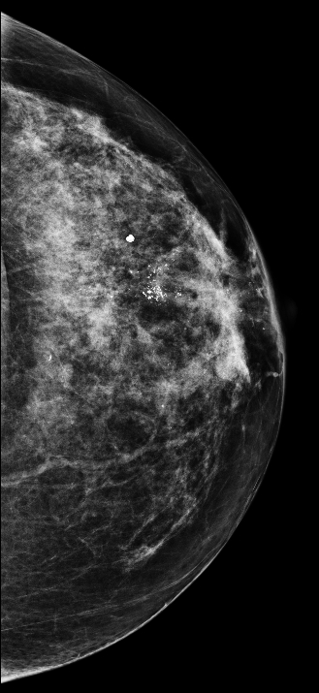
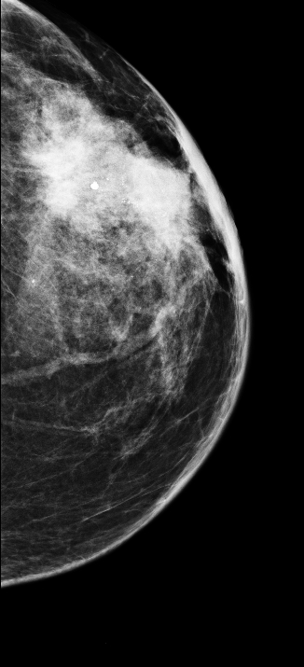
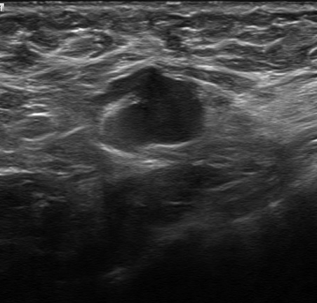
Improvements in equity and access to care can prevent delays in diagnosis and treatment
5 years later

Slide 25



Operationalize Equitable Care
Preferred language
Cultural Preferences
Patient Portal
Insurance Status and Options

Slide 26
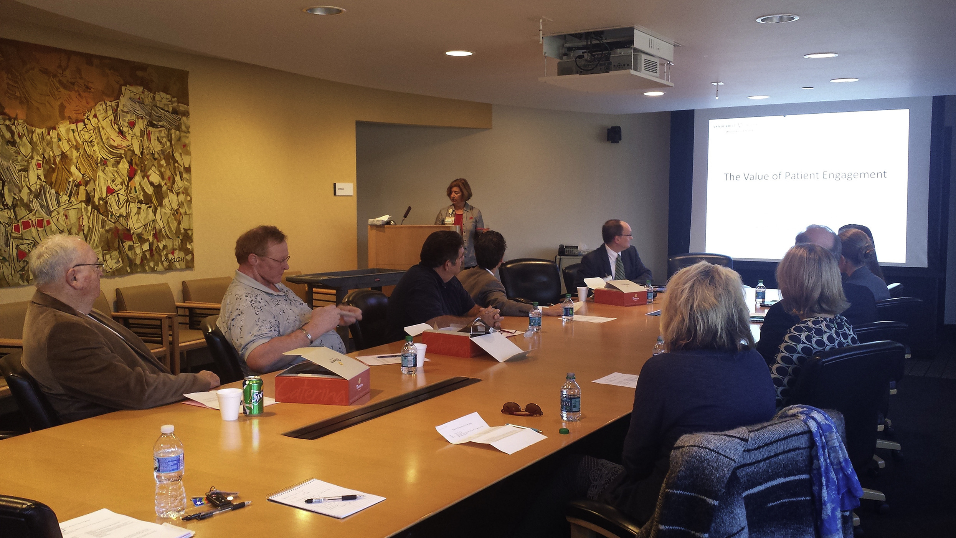
Patient Advisory Groups
Opportunity for patients to share experiences and shape policy change.
Ensure this opportunity is accessible to patients from all backgrounds (location, language, religious preference).

Slide 27
Systems Based Thinking
Recognize the components of the complex medical system
Create opportunities to integrate care

Slide 28
How can we improve equity and access to care?
Patient-centered research
Recognizing disparity
Improving communication
Personalized clinical approaches
Operationalize equitable care
Systems based thinking

Slide 29


Remember: equity is not the same as equality!
=
Equality would be providing the same healthcare to all people. Providing all people with the same access to the same care and the same screening recommendations.
Equity recognizes that different populations and different individuals require different opportunities and resources to achieve their full health potential.

Slide 30
Improving Equity and Access to Imaging requires consideration of the needs of unique populations and people. Requires thinking of solutions that involve patients and recognize the complex healthcare system patients must navigate. Through recognizing the needs of patients, existing disparities, and barriers in access to care we can begin to approach health equity.
THANK YOU!
lucy.b.spalluto@vumc.org
@LBSrad

