Slide 1
Health Care Disparities in Radiology

Slide 2
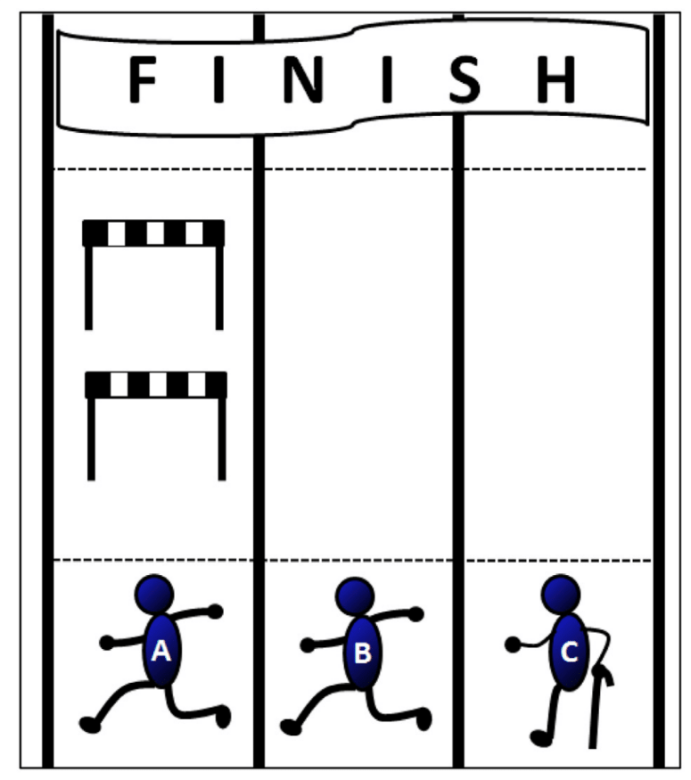
What is a health care disparity?
“differences in the incidence and prevalence of detrimental conditions and outcomes experienced by certain populations when compared with the national average”
Kadom N. U.S Health Disparities – Opportunity for Radiologists. CPDR 2019; 48: 303-304
Notes:
All runners in same race however A in treated unfairly by given hurdles, C only has 1 leg but C race is set up like B race so the race is hair but C only has 1 leg he is a different runner – need to remove hurdles for 1 and give C extra time

Slide 3
Health Care Disparities
The population of the United States has becomes increasingly diverse
Radiologists must learn to both understand and mitigate the impact of health disparities
Health disparities may originate from systematic, unjust differences among groups and communities occupying unequal positions in society
In 2017, the Accreditation Council for Graduate Medical Education updated the Common Program Requirements for residency training programs, adding initiatives in patient safety, quality, and physician well-being

Slide 4
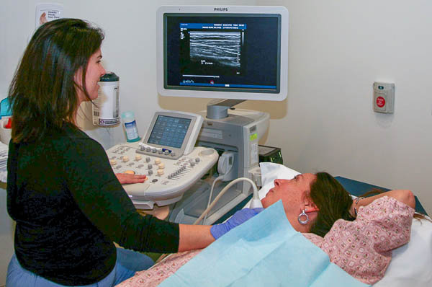
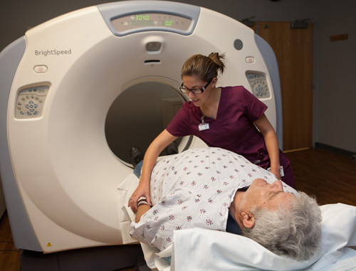
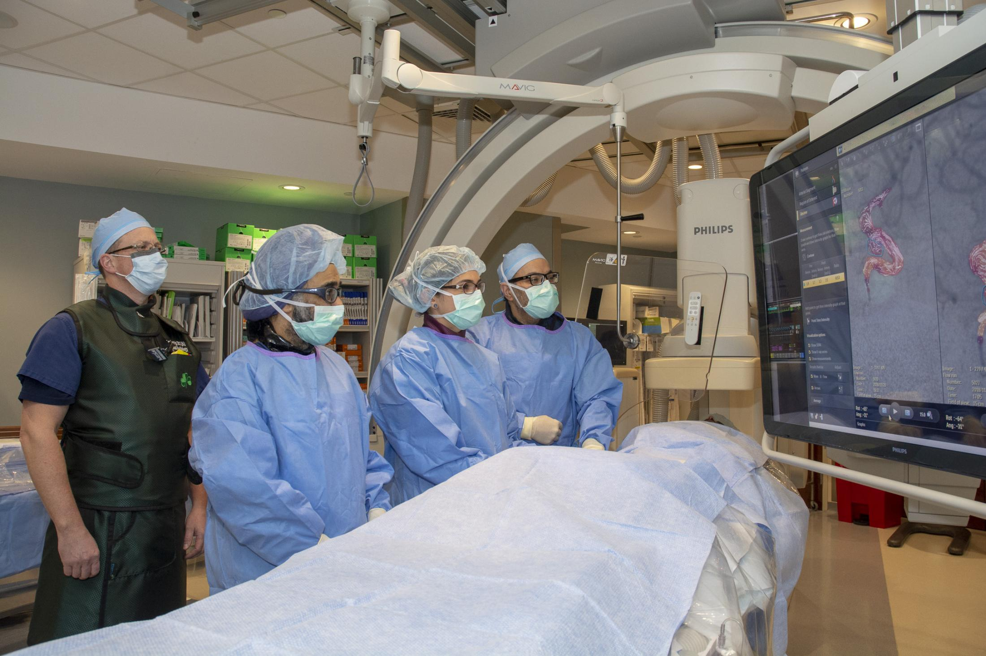
Where do Health Care Disparities Exist in Radiology?
Breast Cancer Screening
Lung Cancer Screening
ED imaging
Access to advanced imaging/interventions
Pain management during image guided procedures

Slide 5

What populations do Health Care Disparities in Radiology Affect?
Ethnic/Racial Minorities (African American, Latinx, Native Americans)
Physically Disabled
Mentally Disabled
Rural/Urban Populations
Uninsured/underinsured populations

Slide 6

Disparities in Breast Cancer Screening
Overall breast cancer mortality rate has declined over the past four decades
Certain populations bear the disproportionate burden of breast cancer morbidity and mortality:
  Racial and ethnic minorities
  Women from lower socioeconomic backgrounds
  Women living in rural areas
  Uninsured Women
Some reasons for these disparities are:
  unequal access to health services
  greater number of comorbid conditions
  lower utilization of screening
  disparities in treatment
Inadequate utilization of screening mammography is an important contributor to higher rates of advanced breast cancer disease and resulting disparities in breast cancer survival in minority populations

Slide 7
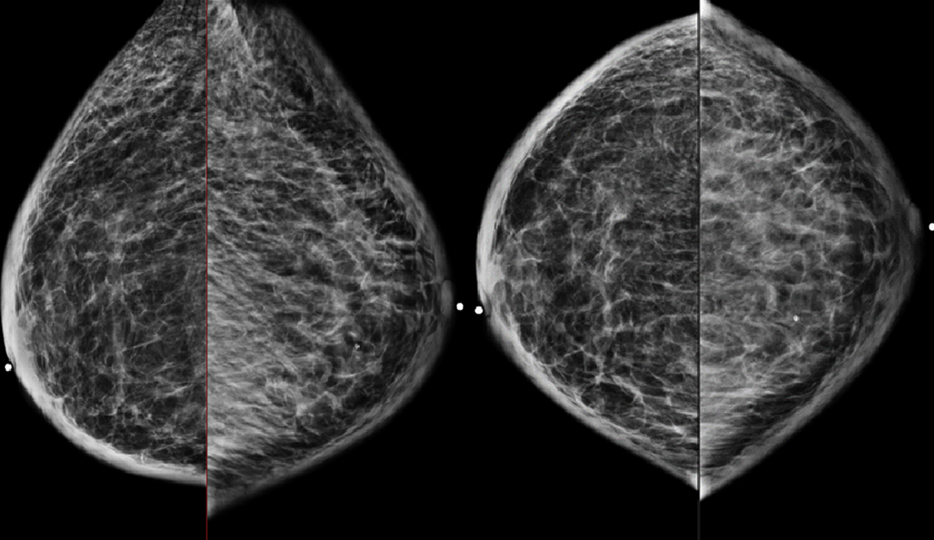
Breast Cancer Screening Disparities and Race
Among racial and ethnic minority women ages 50-74, screening mammography rates are lowest in:
  non-Hispanic American Indian/Alaska Native women
  Hispanic women
  non-Hispanic Asian-American women
American Cancer Society. Cancer Facts & Figures| Hispanics-Latinos | American Cancer Society. https://www.cancer.org/research/cancer-facts-statistics/hispanics-latinos-facts-figures.html
Tolma EL, et al. Conducting a Formative Evaluation of an Intervention Promoting Mammography Screening in an American Indian Community: The Native Women’s Health Project. Am J Health Educ. 2019;50(1):52-65.

Slide 8
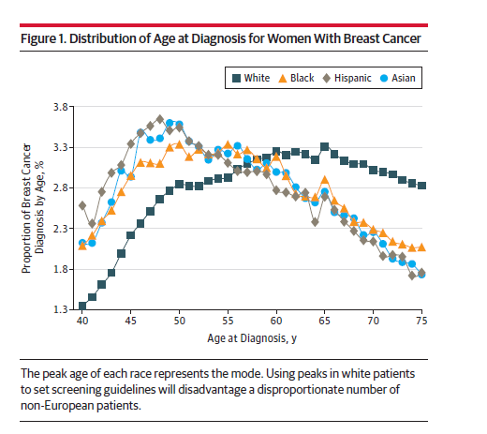
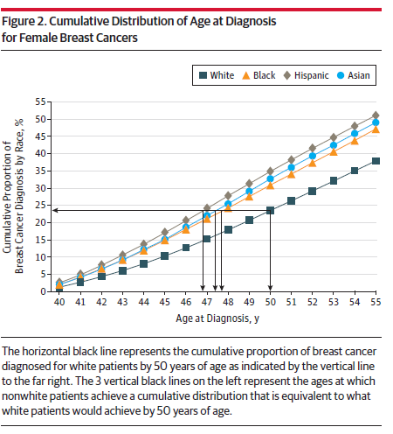
USPSTF Breast Cancer Screening Recommendations and Race
Stapleton SM, et al. Race/Ethnicity and Age Distribution of Breast Cancer Diagnosis in the United States. JAMA Surgery June 2018; 153(6):594-5.

Slide 9
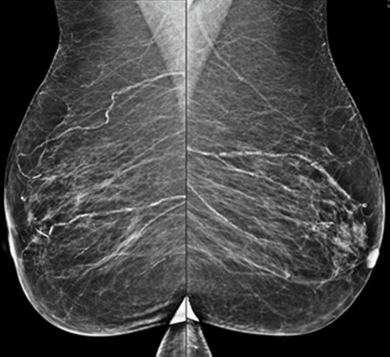
Breast Cancer Screening Disparities and Location
Women in rural locations (compared to urban ones) have fewer available breast imaging facilities
This leads to:
  decreased access
  longer driving distances
  below average utilization of breast imaging services
Chandak A, et al. Rural‐Urban Disparities in Access to Breast Cancer Screening: A Spatial Clustering Analysis. J Rural Health. 2019;35(2):229-235
Jewett PI, et al. Geographic access to mammography facilities and frequency of mammography screening. Ann Epidemiol. 2018;28(2):65-71

Slide 10

Breast Cancer Screening Disparities and Patients with Disabilities
Women with physical disabilities have struggled to:
  Arranging safe and reliable transportation to facilities
  Finding facilities equipped with adjustable mammography units that accommodate for positioning
Women with Disabilities.pdf. https://ww5.komen.org/uploadedFiles/_Komen/Content/About_Breast_Cancer/Tools_and_Resources/Fact_Sheets_and_Breast_Self_Awareness_Cards/Women%20with%20Disabilities.pdf

Slide 11

Breast Cancer Screening Disparities and the LGBTQI Patients
Mixed data
  Some data show breast cancer screening rates of 78% of LGBTQI patients having had a mammogram in the past two years (64% of straight women)
  Other studies have demonstrated lower screening mammography rates for LGBTQI patients
Increasing number of transgender patients undergoing gender-affirming hormonal and surgical interventions
  the relationship between hormone therapy and risk for developing breast cancer is not fully understood
LGBTQI patients have historically faced discrimination and lack of sensitivity from the healthcare community
Consensus guidelines for screening mammography of transgender patients exist
  No evidence-based guidelines have been established
  Creates clinician and patient uncertainty
Lesbian, Gay, Bisexual and Transgender People.pdf.
https://ww5.komen.org/uploadedFiles/_Komen/Content/About_Breast_Cancer/Tools_and_Resources/Fact_Sheets_and_Breast_Self_Awareness_Cards/Lesbian,%20Gay,%20Bisexual%20and%20Transgender%20People.pdf
Sonnenblick EB, et al. Breast Imaging of Transgender Individuals: A Review. Curr Radiol Rep. 2018;6(1):1. doi:10.1007/s40134-018-0260-1

Slide 12
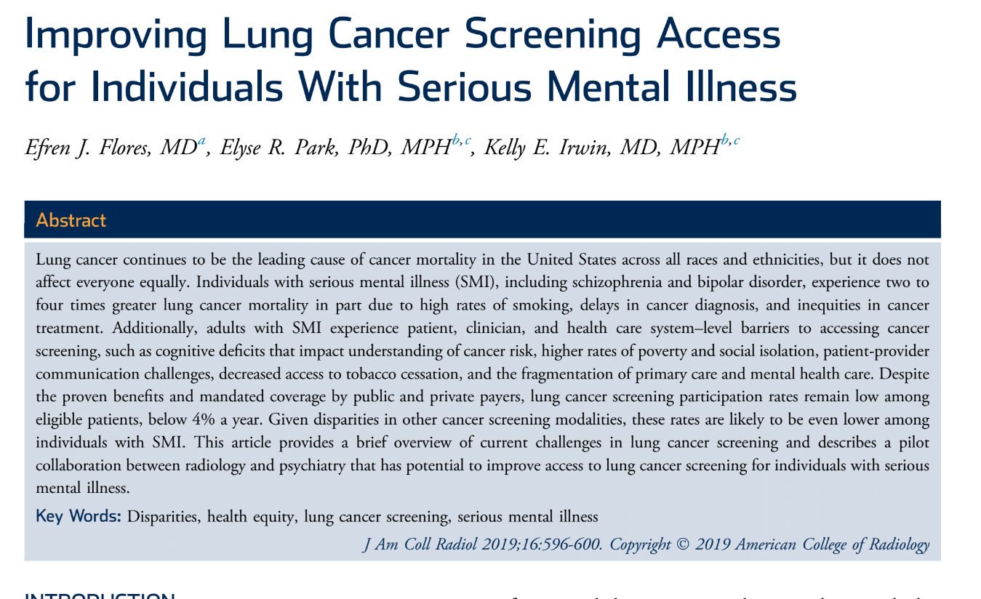
Disparities in Lung Cancer Screening
Individuals with Serious Mental Illness
  Schizophrenia and bipolar disorder
  Second leading case of death in this population is cancer
Individuals with schizophrenia are 2-4x more likely to die from lung cancer due to delays in diagnosis and inequity in cancer prevention, screening, and treatment
More than 50% of serious mental illness currently
smoke
  Studies have shown they are motivated to quit but
  have less access to smoking cessation and lung
  cancer screening programs

Slide 13
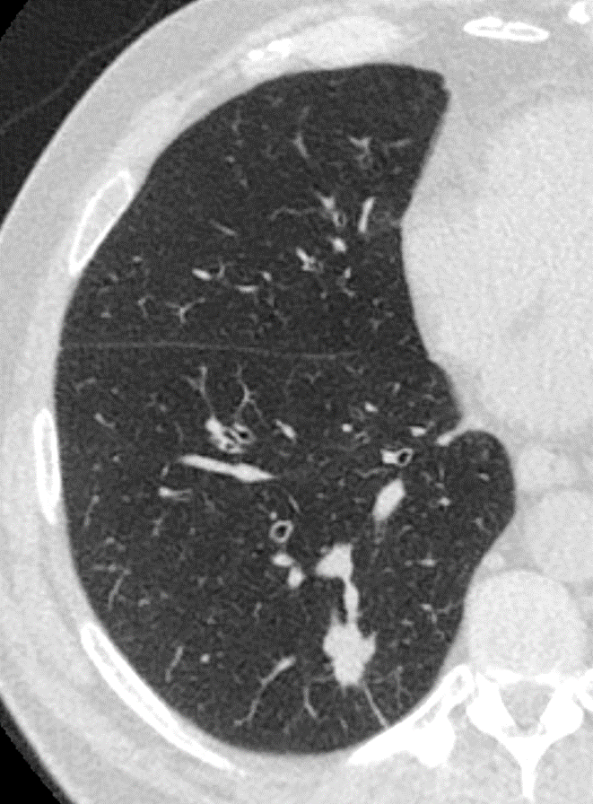
Causes of Disparities in Lung Cancer Screening in the Mentally Ill
Factors influencing low participation of these patients in lung cancer screening are:
  Lack of transportation
  Low socioeconomic status
  Language barriers
  Navigating the complex healthcare system
  Perceived stigma
  Health literacy
  Cultural competency of providers

Slide 14
Bridging the Lung Cancer Screening Gap in the Mentally Ill
1/3 of older patients with schizophrenia are eligible for lung cancer screening
  Eligible patients have limited knowledge about lung cancer risk
  Most underestimate how much smoking increases their lung cancer risk
  Most reported no assistance by psychiatrists or PCPs with smoking cessation
Need targeted multidisciplinary outreach efforts
  Radiologists need to collaborate with psychiatry and PCPs to bridge these gaps in screening for mentally ill patients
CMS requires shared-decision making between the referring physician and the patients for lung cancer screening
  Need tailored counseling session to those with mental illness
  Sessions need to include concrete language, repetition, images, patient stories
  **Radiologists can play a key role in these interventions**

Slide 15
Other Disparities in Lung Cancer Screening
Non-Hispanic black men are 20% more likely to develop lung cancer than white men
Age-adjusted lung cancer mortality for African American men has been about 35% higher than for white men
African Americans have a higher percentage of early onset lung caner (14%) than white (8%)
The lung cancer screening eligibility criteria and age threshold of 55 does not fully apply to underrepresented minorities
  only 4.4% were AA, however they represent 12.3% of the population
When a minority based screening program was performed the positive screening exams doubled in number
Berland et al. Relationships between Health Care Disparities and Coverage Policies for breast, colon, and lung caner screening. JACR 2019; 16:580-85

Slide 16

ED Imaging
Compared to insured persons, nonelderly uninsured and Medicaid patients received (statistically significant) fewer imaging services in the ED and less expensive imaging services when the receive them
  Even after adjustment for level of acuity
African American patients experience longer wait times to radiographic evaluation than white patients
Schranger et al showed white patients received imaging during 51.3% of their encounters, black patients only received imaging 43.6%
  Asians received imaging during 50.8% of their encounters, and other races received imaging during 46% of their encounters
  As compared with white patients, black patients had decreased adjusted odds of receiving imaging in the ED
Moser JW et al. Imaging and Insurance: Do the uninsured get less imaging in Emergency Departments. JACR 2012;9:50-7
Ali I et al Racial Disparities are present in the timing of Radiographic Assessment and Surgical treatment of Hip Fracture. Clin Orthop Relat Res 2020; 478:455-461
Schranger JD et al. Racial and Ethnic Differences in Diagnostic Imaging Utilization During Adult Emergency Department Visiting in the US, 2005-2014. JACR 2019;16:1036-45.

Slide 17
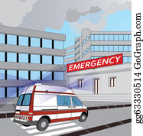
ED Imaging
Rural ED Radiology
  Many rural EDs do not have radiology services in available 24 hours a day
  Lyon et al found that 24.5% of ED patients transferred to a Tertiary ED were due to lack of the necessary radiology services being available at the rural ED
  African American patients were transferred a significantly higher rate than white patients
Pediatric ED Imaging
  Health literacy - the ability to obtain, process, and understand basic health information and services to make appropriate health decisions
  Low health literacy of a pediatric caregiver was associated with less radiologic testing
  Minority race/ethnicity was not associated with less radiologic testing if the caregiver had adequate
  health literacy
Lyon M et al. Rural ED transfers due to lack of Radiology Services. AJEM 2015; 33:1630-34
Morrison AK et al. Health Literacy Affects Likelihood Radiology Rest in the Pediatric Emergency Department. J Pediatr 2015; 166:1037-41.

Slide 18
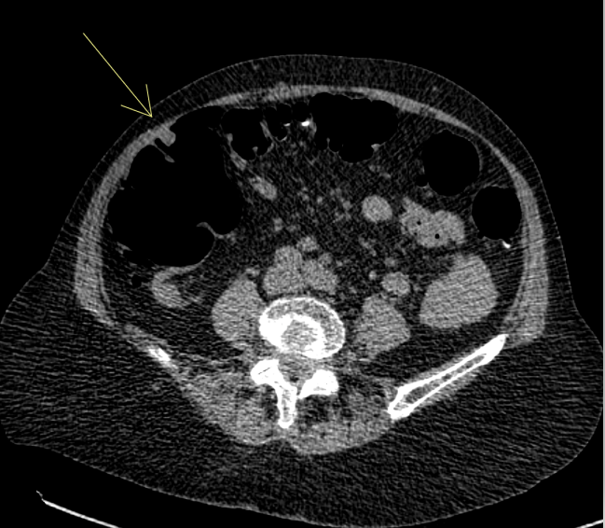
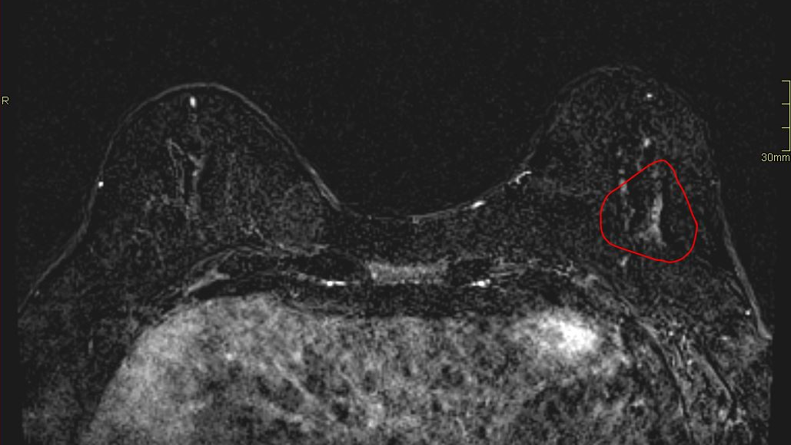
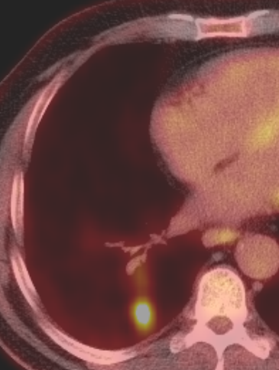
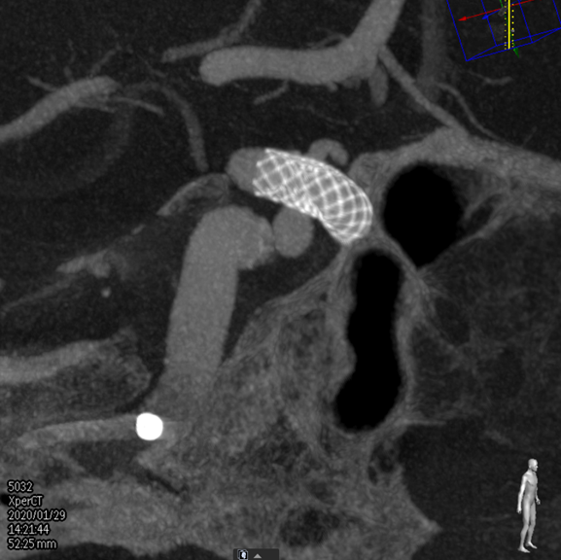
Access to Advanced imaging and interventions
CT Colonography
Aneurysm treatment
Advanced Breast Imaging Technologies
PET CT
Incidental Pulmonary Nodule Follow-up

Slide 19
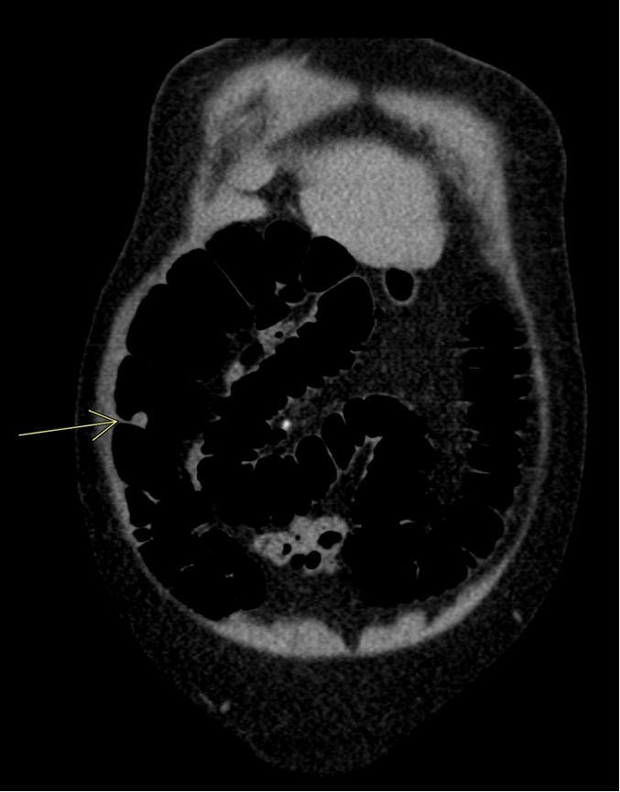
CT Colonography
Over 135,000 new cases of colorectal cancer and over 50,000 deaths yearly in the United States
Colorectal cancer incidence for people ≥50 years has recently declined and death rates have decreased by 34%
Mortality rates have:
  Increased by 13% for those <50 years old
  43% higher in men than in women
  40% higher in non-Hispanic blacks (than non-Hispanic whites)
Black are more likely than whites to be diagnosed with colorectal cancer at younger ages and present with more advanced disease (10.6% occur in blacks before 50yo, 5.5% in whites)
  Most Black patients do not get screening earlier than their white counterparts despite these statics
USPSTF lowered the initial screening age for colorectal cancer to age 45 in 2018
ACS. Colorectal Cancer facts and figures 2017-19. Atlanta GA: ACS;2017
Siegel RL et al. Colorectal cancer statistics, 2017. CA Cancer J Clin 2017; 67:177-93.

Slide 20
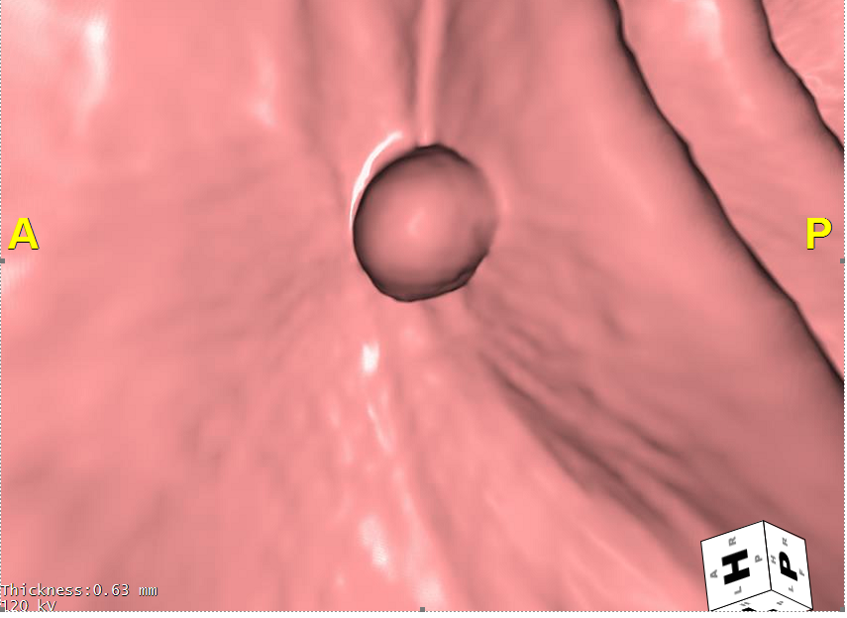
CT Colonography
Blacks with insurance coverage for CT colonography had a 48% greater likely of being screened
77% of patients persevered CT colonography
CT colonography is not covered by Medicare
Could potentially increase screening rates and reduce disparities if CT colonography was covered
Moreno CC et al. Addressing racial disparity in colorectal cancer screening with CT Colonography: experience in an African American cohort. Clin Colorectal Cancer 2018;17:363-7

Slide 21
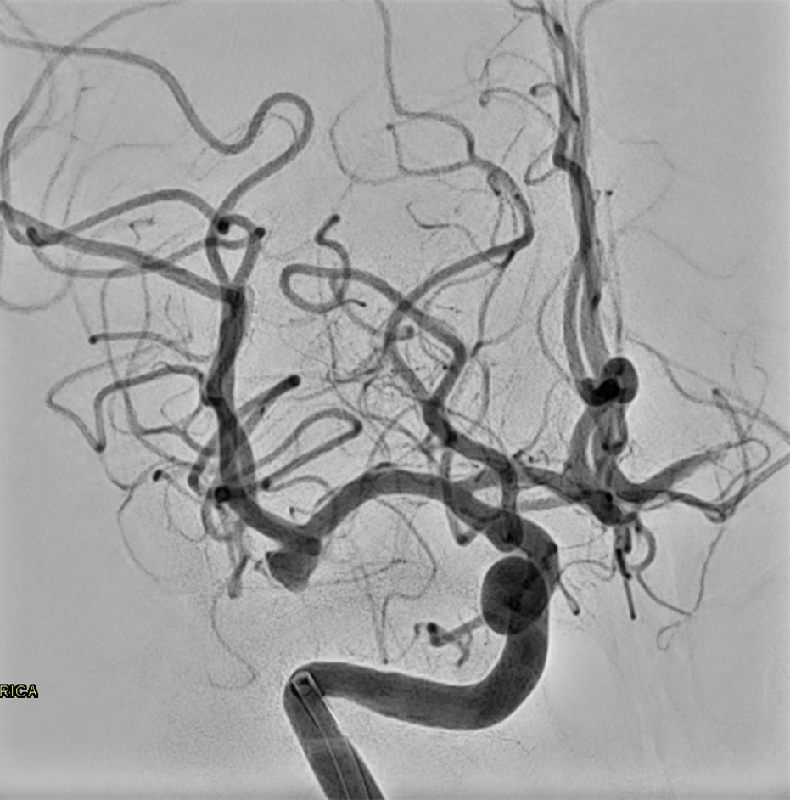
Aneurysm Treatment
Patient undergoing surgical and endovascular treatment for unruptured intracranial aneurysm were found to be of a higher socioeconomic status and more likely to be insured , white, and female
A higher proportion of those treated for subarachnoid hemorrhage (SAH) were minorities and uninsured
Patient with higher socioeconomic status have more access to the healthcare system and advanced medical imaging
  More likely to have their aneurysm found before it ruptures
  More likely to have advanced intervention
Patients who lack financial resources are less likely to have elective or advanced
surgical procedures/techniques
Brinjikji W et al. Racial and Ethnic Disparities in Treatment of Unruptured Intracranial Aneurysms. Stroke 2012; 43:3200-3206

Slide 22

“No Shows” to Imaging Appointments
Patients with commercial insurance have a significantly lower rate of “no shows” (5.2%) compared to Medicare(6.3%)/Medicaid(14.5%)/self-pay(12.0%)
Other factors that were significant in contributing to “no shows” were:
  Non-commercial insurance
  African American
  Hispanic
  Language other than English or Spanish
  Male gender
  Age ≥65
  Home zip code with a median household income <$50,000
Possible Solutions:
  Better support of multilingual patients (online registration, informational videos, etc)
  Assisted transportation (courtesy shuttles)
  Cost Transparency and payment plans
  Cultural competency training (implicit bias)
  Patient-centered, Preference-Based Algorithms (identify risk factors for no shows)
Glover M et al. Socioeconomic and Demographic Predictors of Missed Opportunities to Provide Advanced Imaging Services. J Am Coll Radiol 2017; 14:1403-11.

Slide 23
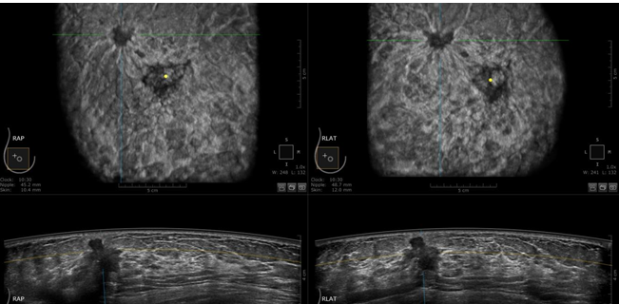
Advanced Breast Imaging Technology
Advanced Breast Imaging Technologies
  Tomosynthesis
  Automated Breast Ultrasound
  MRI
Mammography screening benefited from the Patient Protection and Affordable Care Act (PPACA),expanding mandatory health insurance coverage for routine preventive services and prohibiting cost sharing for screening mammography
  There is NO requirement for insurance coverage of supplemental screening modalities
Studies have shown these technologies are unequally adopted
  Vulnerable populations are disproportionately affected by this
These technologies are:
  Less geographically accessible
  Associated with a higher out-of-pocket expense/co-pay
Miles RC et al Addressing Potential Health Disparities in the Adoption of Advanced Breast Imaging Technologies. Acad Radiol 2018 25(5): 547-51

Slide 24
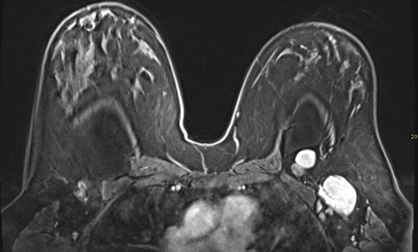
Advanced Breast Imaging Technologies
Screening Breast MRI
Among women with a <20% lifetime risk of breast cancer non-Hispanic white women were 62% more likely to receive an MRI than non-white women
Women with college education were 132% more likely to receive an MRI compared to those with lower levels of education
Among women with ≥20% lifetime risk (high risk), those with a high school education or less were less likely to receive screening MRI than women who had graduated from college
Haas JS et al. Disparities in the Use of Screening Breast MRI in Community Practice by Race, Ethnicity, and Socioeconomic Status. Cancer 2016; 122(4):661-17

Slide 25
PET CT
Blacks have worse outcomes (5-year all-stages survival rate of 15%) compared to non-Hispanic whites (18%)
Blacks are less likely to undergo PET or CT imaging at lung cancer diagnosis compared with non-Hispanic whites
PET with CT was associated with improved survival
Cause of this disparity is unknown however studies have suggested this can be due to intuitional/unconscious bias
Morgan RL et al. Ethnic Disparities in Imaging Utilization at Diagnosis of Non-Small Cell Lung Cancer. JNCI 2020;112(12)

Slide 26
Racial/Ethnic Disparities in Incidental Pulmonary Nodule Follow-up
nonwhite patients were less likely to meet each step of the follow up cascade than White patients
Provider-patient IPN communication, 55% among Black patients and 80% among White patients
Follow-up ordering and scheduling, 42% and 41% among Black patients and 66% and 64% among White patients
Timely adherence, 29% among Black patients and 54% among White patients.
Adjusting for provider communication, sociodemographic, and health characteristics, Black patients had increased odds of never adhering to and delaying follow-up compared with White patients (odds ratios, 1.30 and 2.51, respectively)
Schut RA et al. Racial/Ethnic Disparities in Follow-Up Adherence for Incidental Pulmonary Nodules: An Application of a Cascade of-Care Framework. J Am Coll Radiol 2020;17:1410-1419.

Slide 27

Pain Management During Interventions
Black Americans are systematically undertreated for pain relative to white American
Has been tied to false beliefs about biological differences between blacks and whites (e.g. "black people’s skin is thicker than white people’s skin”)
Relative to non-Hispanic white patients, non-Hispanic black patients and patients of other races/ethnicities had 22%–30% lower risk-adjusted odds of analgesic receipt for acute abdominal pain the ED
  They had 17%–30% lower risk-adjusted odds of narcotic analgesic receipt
Hoffman KM et al. Racial bias in pain assessment and treatment recommednations, and false beliefs about biological difference between blacks and white. PNAS 2016; 113:4296-4301
Shah AA et al. Analgesic Access for Acute Abdominal Pain in the Emergency Department Among Racia/Ethnic Minority Patietns. Medical Care 2015; 53: 1000-1009

Slide 28
Summary
Healthcare disparities exist in multiple areas of Radiology
Image based screening (such as lung cancer screening CT, screening mammography, CT colonography) are where large disparities exist
Disparities are seen in ED imaging especially in rural areas and in pediatric Eds
Advanced imaging and interventions show disparities especially among insurance and education level of patients
Disparities in the treatment of pain in minority patients in the ED have been shown to exist
  Radiology should be cognizant of these issues when performing image guided procedures to ensure all patients have adequate pain management and bias is minimized

